Slide 1


# Pizza Sales Data Analysis using SQL Project to analyze pizza sales data for business insights. Showcasing SQL skills for data professionals and recruiters. Unveiling hidden trends and revenue drivers.
by Himanshu Prasad

Slide 2



Dataset Overview
Orders: order_id, date, time Pizzas: pizza_id, pizza_type_id, order_id, quantity Pizza Types: pizza_type_id, name, category, ingredients, price
Publicly available pizza sales dataset. Essential for detailed revenue and trend analysis. Clean data ensures reliable results.

Slide 3

Business Questions Solved: Basic
Total Revenue: Calculate total sales across all orders. Helps understand overall performance. Daily/Hourly Trends: Identify peak ordering times. Optimize staffing and promotions.
Query Example:SELECT SUM(price * quantity) AS total_revenue FROM pizzas JOIN pizza_types ON pizzas.pizza_type_id = pizza_types.pizza_type_id

Slide 4

Business Questions Solved: Intermediate
Top Selling Pizzas: Determine most popular pizza types. Focus marketing on top performers. Category Performance: Compare sales across different categories. Optimize menu offerings.
Query Example: SELECT pizza_types.name, SUM(pizzas.quantity) AS total_quantity FROM pizzas JOIN pizza_types ON pizzas.pizza_type_id = pizza_types.pizza_type_id GROUP BY pizza_types.name ORDER BY total_quantity DESC LIMIT 5

Slide 5
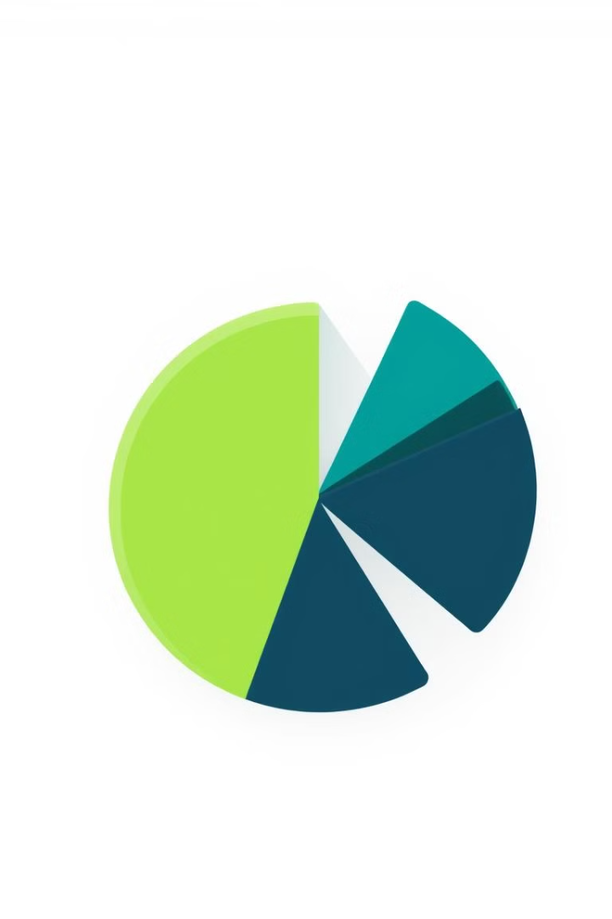
Business Questions Solved: Advanced
Revenue by Ingredient: Key ingredients driving sales. Guide sourcing and menu innovation. Impact of Pizza Price: Analyze price elasticity. Optimize pricing for maximum revenue.
Query Example: WITH ingredient_revenue AS (SELECT ingredient, SUM(price * quantity) AS revenue FROM pizzas JOIN pizza_types ON pizzas.pizza_type_id = pizza_types.pizza_type_id, UNNEST(STRING_TO_ARRAY(ingredients, ', ')) AS ingredient GROUP BY 1) SELECT * FROM ingredient_revenue ORDER BY revenue DESC LIMIT 10;

Slide 6

Visualizing Insights
Total Revenue: Line graph showing monthly trends. Spot seasonal changes. Top Selling Pizzas: Bar chart comparing pizza type quantity. Quickly identify best sellers. Category Performance: Pie chart illustrating sales distribution. Understand market share.

Slide 7


Technologies Used
SQL: PostgreSQL (or MySQL, SQLite). Powerful for data manipulation. Relational Databases: Data modeling and schema design. Ensures database integrity.
Tools for creating charts and graphs. Data visualization makes insights clear.

Slide 8


Conclusion & Call to Action
Key Takeaways: SQL proficiency. Actionable insights. Data analysis skills. Skills Learned: Data cleaning. Complex queries. Data visualization. Problem-solving.
GitHub: [Link to your GitHub repository containing SQL scripts and analysis] Connect on LinkedIn!

